Slide 1
Welcome to 4th Grade!
Miss Goldinger

Slide 2
About Miss Goldinger
Master’s Degree: Special Education (In Progress)
Bachelor’s Degree: Early Childhood Education
Fourth year with the Freeport Area School District
Spent the past two years teaching 3rd grade and Kindergarten here at Buffalo
Hobbies: Running, Crossfit, cheering on the Penguins, spending time with my family and friends, kayaking, boating, and visiting the Outer Banks each summer ☺

Slide 3

Supply List
3 ring binder with a zipper
Pencils with erasers
Protractor
Black Fine-Tip Sharpie
Highlighter
Dry erase markers
2 Folders

Slide 4
Classroom Rules:
Follow all school rules
Be respectful of other people and their belongings.
Be responsible for school property, your property, and your actions.
Be prepared for class.

Slide 5
Positive Behavior Incentives
Collecting squares as a class on our Behavior Bingo board for good behavior
Praise and positive notes home

Slide 6
Consequences of Breaking Rules:
Verbal Warning
5 Minutes off recess
10 Minutes off recess
Loss of recess
Note/Call Home
Referral to Mr. Poleski

Slide 7
Grading Scale
91-100 A
81-90 B
70-80 C
60-69 D
0-59 F

Slide 8
Grades
Please refer to Power School to routinely check your child’s grades.
Progress Reports will be given at the mid-nine week point

Slide 9
4th grade class information:
Mrs. Welling will teach reading, writing, and grammar.
Miss Goldinger will teach math and alternate between teaching science and social studies.
Spelling will be taught by the homeroom teacher.

Slide 10
Math with Miss Goldinger
Math Series: My Math ~ This series is aligned to the Common Core Math Learning Standards
Topics covered include:
  Place Value
  Adding and Subtracting Whole Numbers
  Understanding Multiplication and Division
  Multiplying and Dividing with One-Digit Numbers
  Multiplying with Two-Digit Numbers
  Patterns and Sequences
  Fractions and Operations
  Decimals
  Measurement
  Perimeter and Area
  Geometry

Slide 11
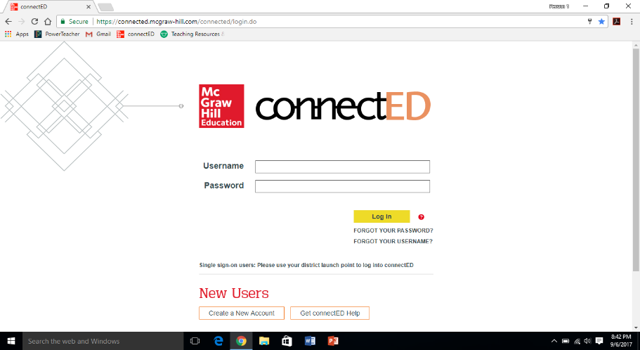
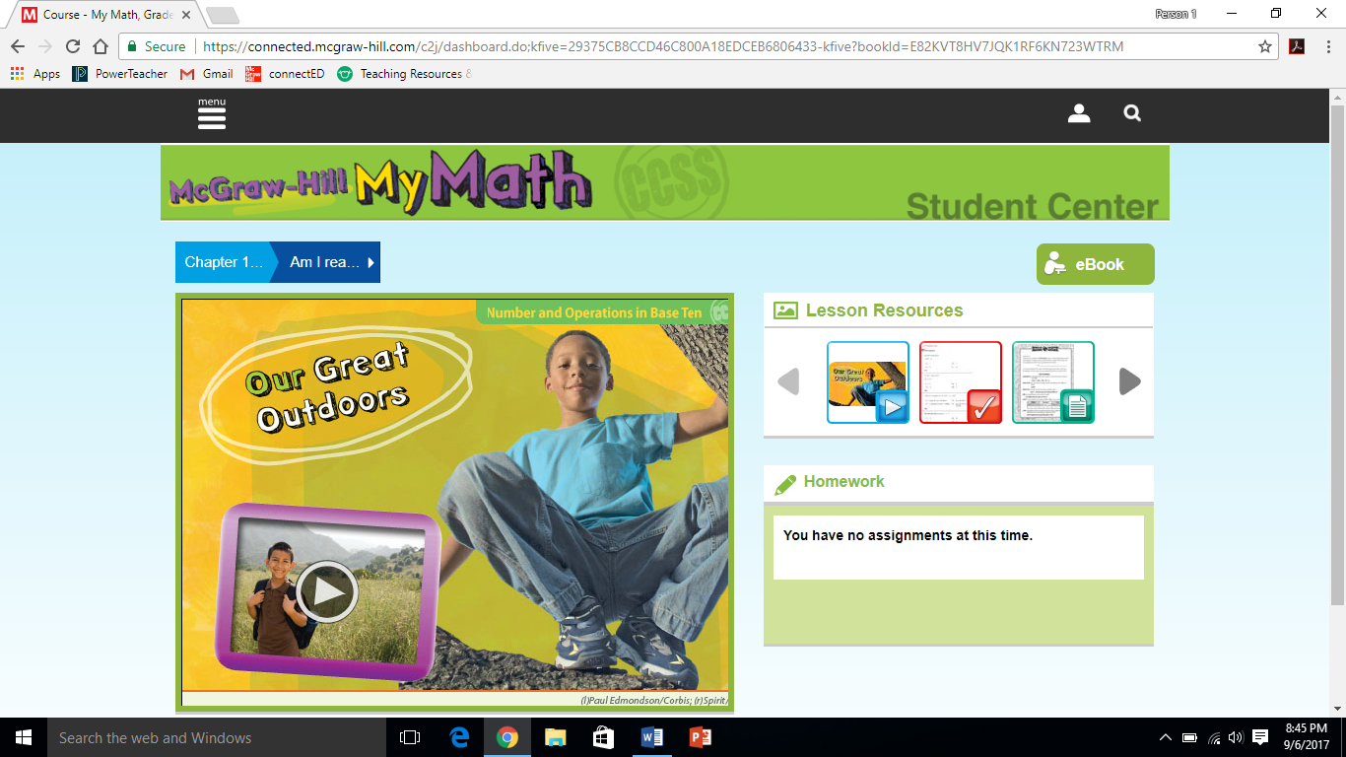
Math Continued..
Online resources - https://connected.mcgraw-hill.com/connected/login.do
  Username: BUFFMATH4 password: fasd2017

Slide 12
Science with Miss Goldinger
Scott Foresman Science Curriculum
Various units of study
  Life Science
  Physical Science
  Earth Science
  Human Body
Students will be tested in Science on the PSSA’s in 4th grade

Slide 13
Social Studies with Miss Goldinger
McGraw Hill Regions Curriculum
Focus on United States regions and people
Many projects and activities
Alternates with Science

Slide 14
Reading with Mrs. Welling
Reading Series: Journeys ~ This series is aligned to the Common Core ELA Learning Standards
It includes reading, grammar, writing, and spelling.
Students will have whole group and small group instruction.
Leveled readers are used weekly with reading stations and materials that are differentiated.

Slide 15
Reading with Mrs. Welling continued…
The Selection Tests and Vocabulary Quizzes will be given on Day 6
Book Sharing Letters/Independent Reading of chapter books

Slide 16
About Journeys…
With Journeys © 2017, readers are empowered by skill mastery; inspired by authentic, award-winning text; and confident that they are building the skills needed for college and careers. Backed by proven results, Journeys is the most widely-used reading program in the country. Journeys is a research-based, comprehensive English Language Arts program designed to provide solid instruction that is clear and focused with realistic pacing and manageable resources.
Journeys in the classroom
Access the complex Anchor Text using a practical routine to analyze deeply
Flexible for teachers with powerful tools to reach all learners
Complete suite of integrated assessments to improve achievement
(Information from http://www.hmhco.com/shop/education-curriculum/reading/core-reading-programs/journeys)

Slide 17
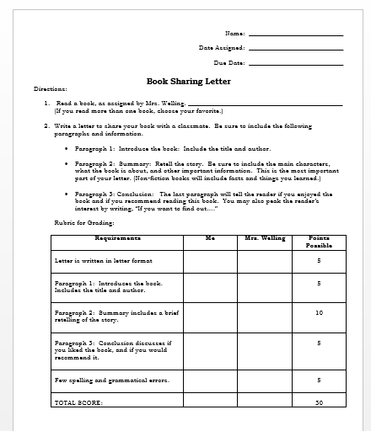
Students will read chapter books independently and share their books by writing book sharing letters to friends.

Slide 18
Reading Skills
Figurative language
Multiple meaning words
Textual evidence
Character, setting, plot
Theme
Summarizing
Poetry
Dialogue
Point of view (first- and third-person)
Drawing inferences
Main idea and supporting details
Sequence of events
Problem/solution
Integrate information from two texts on the same topic
Fluency
Roots and affixes

Slide 19
Grammar
Relative pronouns (who, whose, whom, which, that)
Relative adverbs (where, when, why)
Progressive verb tenses (will be walking)
Modal auxiliaries (can, may, must)
Order adjectives
Prepositional phrases
Sentences, fragments, and run-ons
Homophones
Conventions
Grammar Quizzes will be given on Day 5

Slide 20

Writing
Writing Process
  Prewrite
  Draft
  Revise
  Proofread
  Publish
Writing Styles
  Personal Narrative
  Persuasive
  Opinion Writing
  Informational Writing / Research Project

Slide 21
Spelling
Test every Friday
Lists are leveled
Complete Spelling contracts for each weekly list
  Contracts are due every Friday before the test

Slide 22
Schedule for our Assessments in Reading/Language Arts
Spelling Tests: Fridays
Grammar Quizzes with a “Cold Read” : Day 5
Reading Assessments: Day 6 (Selection Test and Vocabulary Quiz)

Slide 23
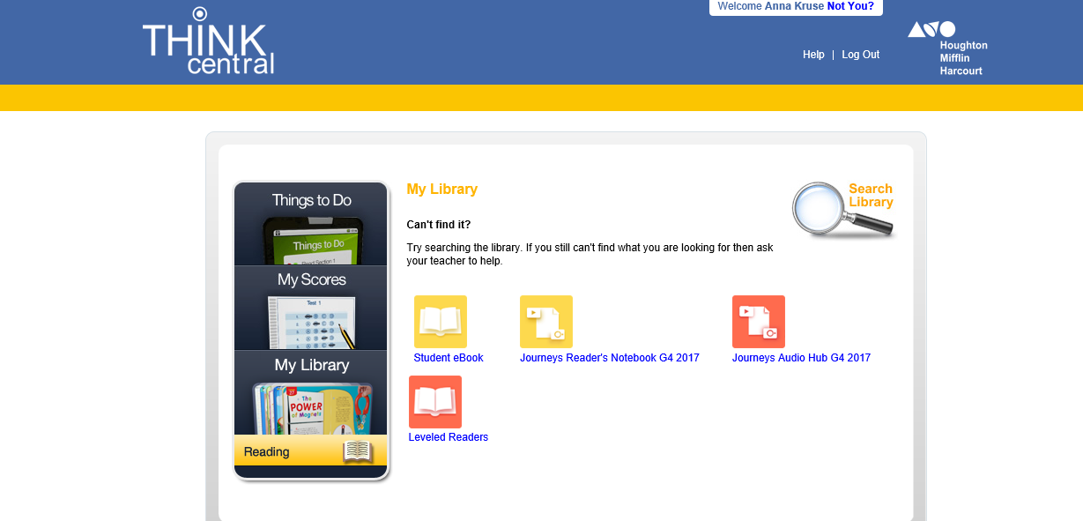
Visit Think-Central for on-line access to the
textbook and materials for Journeys.

Slide 24
Homework
Reinforces what was taught
Teaches responsibility
Class time is often given to begin assignment
Most homework assignments are worth 1 point each
Math homework is assigned almost every night
Writing, Grammar, Science, and Social Studies as needed

Slide 25
Homework
Check your child’s planner every day. Please sign at least weekly.
Make homework a habit.
Plan for a place to complete homework with supplies.
Supervise the work, but do not complete the work for him or her.
Contact me if you have any questions.

Slide 26
Missed Work and Late Work
Due as soon as possible
I will set a due date with your child depending on circumstances.
Please call or email before 9:00 to request work sent home. (E-mail is preferred.)
Late work may be turned in one school day late for ½ credit.

Slide 27

Specials
Music and Computer (Day 1)
Health (Day 2)
Library (Day 3)
Computer (Day 4)
Art (Day 5)
  Bring a paint shirt in a big Ziploc bag with your child’s name written on the tag and the bag
P.E. and Choir (Day 6)

Slide 28
DIBELS
Dynamic Indicators of Basic Early Literacy Skills
  Fluency, Comprehension, and Retell
Administered up to three times a year
Goal: Students meet and/or exceed grade level benchmarks
Share outcomes at conferences

Slide 29
PSSA Practice
Practice independent reading of passages
Learn helpful test-taking strategies
DATES of 2018 Testing Window
  ELA: April 9-13
  Math: April 16-20
  Science: April 23-27

Slide 30
RtII
All students receive extra practice based on individual performance and needs
Enrichment provided
Multiple teachers to provide smaller groups

Slide 31
Lunch
Please send money in an envelope with student’s first and last name
Lunch: 12:55 – 1:25 pm

Slide 32
Snacks
Please send nut free snacks. Refer to allergy paper sent home.
Please send nutritious snacks that are not messy.
Nutritious: cheese, fruit, vegetables, pretzels, granola bars
No candy
Water bottles are permitted and should go home each day.

Slide 33
Recess
A note is required to stay inside.
Please dress for the weather.

Slide 34

Scholastic
Every month
Online ordering
Great way to build excitement about reading
Checks ONLY made out to Scholastic Book Clubs
Class Code: RF94T

Slide 35

Birthdays or Celebrations
Please let me know in advance if you will be sending a treat to school.
Cookie cakes or cakes should be cut prior to sending them to school
Pre-packaged
Please send in plates or napkins.
Allergies

Slide 36
Conferences and Contact Info
Parent Conferences
  Fall Conference: November 9 and 10
  Spring Conference: February 15 and 16
School: 724-353-9577
  Ext. 4023
Email: goldinger@freeport.k12.pa.us

Slide 37
Bullying
Meetings in the classroom
Consequences
  1st offense: written explanation by student to be signed by parent
  2nd offense: written explanation, student calls home with teacher, one silent lunch
  3rd offense: written explanation, student calls home with teacher, two silent lunches
  4rd offense: parents are contacted to schedule a meeting, individual plan for the student

Slide 38
Thank you for taking the time to come tonight!
I look forward to working with
you and your child this year!
Miss Goldinger

